Slide 1
Welcome to Parent Orientation Night!
Mrs. Howard
Third Grade
Room 206

Slide 2
Thank You!!!
Thank you so much for coming tonight. I know how crazy schedules can be and your child and I appreciate that you took time out to come see our classroom!

Slide 3
Homework
Homework is given Monday through Thursday
On Mondays students will receive a spelling worksheet to complete and bring back on Tuesday
On Monday or Tuesday students will receive their spelling contract
They are asked to complete three activities
Returned on Friday before spelling test
If students don’t finish work at school they may be asked to bring their work home and complete for the next day
Average time for homework a night should be 10-15 minutes

Slide 4
Agendas
Students fill out their agendas in the afternoon
These do not need to be signed every night unless homework completion becomes an issue
The agendas should be taken home every day and returned to school the next day

Slide 5
Spelling
Every Monday students will take a spelling pretest. If the student does not miss any words, they will be given a set of 8 challenge words to study for the test on Friday.
On Tuesday, students will bring home their spelling contract.
They must complete three activities and return the spelling contract on Friday before the spelling test.

Slide 6
Friday Folders and Notes
Friday folders are sent home on the last day of the school week and should be returned EMPTY on the next school day (typically Monday).
In the Friday folder there will be graded homework, quizzes, or tests and any handouts.
There will also be a Friday note in the Friday folder
Needs to be signed and returned
Can leave comments or questions on Friday note and I will get back to you!

Slide 7
Behavior Expectations
At Irving we have school wide expectations
Be Respectful (Rt)
Be Responsible (Rb)
Be Safe (S)
Consequences for not following these expectations:
Students can earn a mark if they are not following expectations
1-2 marks: Warning
3-4 marks: One-on-one conversation with teacher or timeout
5 marks: Parent contact
6 marks: Detention
Beyond 6: Meeting with principal

Slide 8
PBIS
We are a PBIS school. PBIS stands for Positive Behavior Intervention and Support Program.
We work on establishing clear expectations with students
Students can earn time at Friday Free Choice
They can also earn Mustang Money from staff for following school expectations
They can spend their Mustang Money at the mustang mall on Thursdays!

Slide 9
Friday Free Choice
Students are always working towards earning time at Friday Free Choice
They earn Friday Free Choice by not earning a lot of marks during the week and turning in all their homework

Slide 10
Reading Counts
Students take a test on the computer to give them a “lexile” level. This lexile helps them choose books that are right for them.
Students read books and then take a quiz on the computer.
If they pass the quiz they earn points.
They can earn prizes and rewards based on the number of points they earn

Slide 11
Testing, Conferences, and Report Cards
Parent teacher conferences are the week of October 19th. Sign up will be sent home as the date nears.
Report cards are sent home 2nd, 3rd, and 4th quarter.

Slide 12
Birthday Treats
We love to celebrate birthdays, but please let me know ahead of time if you plan to send treats.
Prepackaged items that can be handed out easily are best.

Slide 13
Book Orders
Book orders will be sent home once a month.
You can send a check or cash. Write checks out to Scholastic.
I may send home multiple book orders. If you order from more than one, you only need to write one check.
You can also order online by logging onto www.scholastic.com
Create a username and password and search for my name! Our class activation code is NDRLL

Slide 14
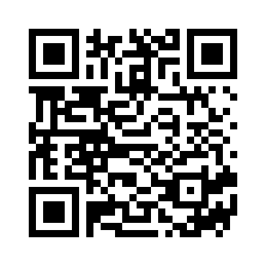
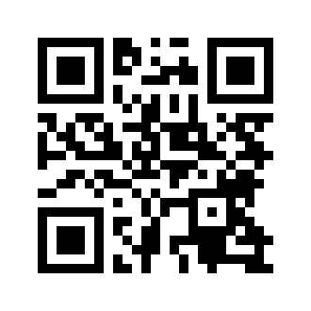
Class Website
I have created a class website. You can find some information about our routines and what we are learning.
Please visit http://marahoward.weebly.com/
Become a member of our shutterfly page to see pictures that I take throughout the year
Website
Shutterfly

Slide 15
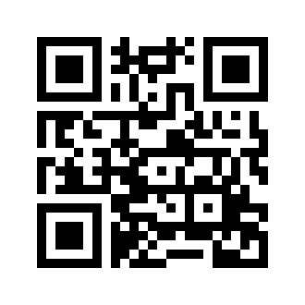
Ways to Get Involved
PTO Meetings
Generally one Thursday a month from 6:00-7:00 in the school teacher’s lounge
Does not require any membership fees
Come share your ideas with the PTO to continue to make Irving the best school for your child!
Our next meeting is Thursday, October 8th at 6:00
Back to School Bash
Next Thursday PTO hosts our Back to School Bash at the school from 5:00-7:00
Bounce houses, cotton candy, snow-cones, popcorn, tattoos, tables set up from various organizations

Slide 16
Class Schedule
Monday
P.E. 9:05-9:35
Music 9:35-10:05
Tuesday
P.E. 9:05-9:35
Music 9:35-10:05
Wednesday
Art 9:05-10:05
Thursday
Learning Center 9:05-9:50
Book Checkout 9:50-10:05
Friday
P.E. 1:55-2:25
Everyday
Lunch 11:50-12:10
Recess 12:10-12:30

Slide 17
Ways to Contact Me
You can contact me by e-mail at:
howardm@district87.org
You can also contact me at school at 827-8091 before school, during our class’s specials, or lunch
I have set up a “Remind” account that allows me to send messages to your phone without having to exchange phone numbers. To be a part of this, either download the app or visit their website at remind.com
Text 81010 with message “@mrshoward3” to receive messages as texts
Thanks for all of your support! If you have any questions, don’t hesitate to ask!

Slide 18
Feel free to take a look around!
Write a note for your child to get tomorrow morning!
Take a look around the classroom
Ask any questions you may have
Thanks again for coming!

